Slide 1
Academic presentations as storytelling

Slide 2
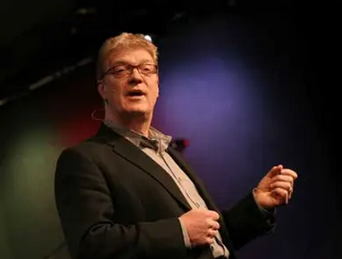
Do schools kill creativity?
A Ted Talk by Ken Robinson

Slide 3
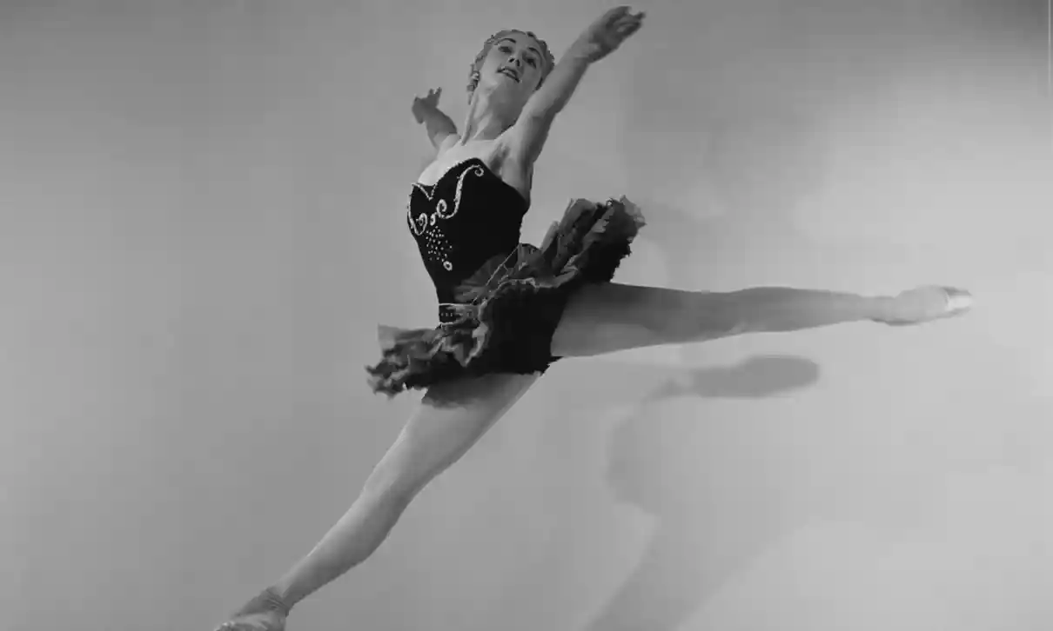
A born dancer: a story.
Notes:
https://www.npr.org/2014/10/04/353679082/dancer-needed-to-move-to-think
They serve as a starting point for inquiry or can be an argument themselves.

Slide 4
What is a story?
Essentially, a story expresses how and why life changes.
Robert McKee
Notes:
McKee Film writing consultant whose students have written, directed or produced films such as Forrest Gump, Erin Brockovich, The Color Purple, Gandhi, Monty Python and the Holy Grail, Sleepless in Seattle and so on.

Slide 5
What are the parts of a story?
It begins with a situation.
Something happens.
The protagonist struggles.
Balance is restored.
We ultimately learn the truth.
McKee
1. the setting and
a complication.
2. rising action.
3. the climax and
4. falling action.
5. the resolution.

Slide 6
A born dancer: in three acts.
Act one
Act two
Act three
climax
falling action
rising action
complication
setting
resolution
Notes:
11.2 hours long

Slide 7
A born dancer: in three acts.
Act one
Act two
Act three
climax
falling action
rising action
complication
a learning disorder
resolution
Notes:
11.2 hours long

Slide 8
A born dancer: in three acts.
Act one
Act two
Act three
climax
falling action
rising action
a specialist
a learning disorder
resolution
Notes:
11.2 hours long

Slide 9
A born dancer: in three acts.
Act one
Act two
Act three
climax
falling action
a born dancer
a specialist
a learning disorder
resolution
Notes:
11.2 hours long

Slide 10
A born dancer: in three acts.
Act one
Act two
Act three
dance school
falling action
a born dancer
a specialist
a learning disorder
resolution
Notes:
11.2 hours long

Slide 11
A born dancer: in three acts.
Act one
Act two
Act three
dance school
a wonderful career
a born dancer
a specialist
a learning disorder
resolution
Notes:
11.2 hours long

Slide 12
A born dancer: in three acts.
Act one
Act two
Act three
dance school
a wonderful career
a born dancer
a specialist
a learning disorder
pleasure for millions
Notes:
11.2 hours long

Slide 13
And the presentation itself can be a story.
a narrative structure.
unity and coherence.
purpose and drive.

Slide 14
Varieties of Hermeneutical Injustice: A Blueprint.
        1. Introduction.
        2. A Concept of Hermeneutical Injustice.
        3. A Blueprint for Discovering New Varieties.
        4. A Further Variety.
        5. Hermeneutical Justice Broadly Conceived.
Notes:
Beginning with goal/problem
Method

Slide 15
Hermeneutical injustice: in three acts.
Act one
Act two
Act three
a new variety
three varieties
a framework
a blueprint and the search
hermeneutical wrongs
two stories
and a concept
a new definition
two stories
setting & inciting incident
rising action & climax
falling action & resolution
Notes:
1. Two stories: a woman who after childbirth feels depressed instead of elated and blames herself, as does her husband and others. And a woman who “feels ashamed and embarrassed” by the sexual advances her superior at work made towards her. She quit her job.
2. A concept of hermeneutical injustice

Slide 16
Your narrative arc.
Act one
Act two
Act three
your solution
how you solve the problem
evaluate your solution
a big idea
a problem that matters
awaken our interest
tell us what you learned
setting & inciting incident
rising action & climax
falling action & resolution

Slide 17

Momentum.
Momentum was the onward drive of narrative, the raising of questions to which the audience desired to know the answers.
David Lodge in Author, Author,
where Henry James compares writing to
riding a bicycle
Notes:
Not simply tension as conflict.
Covering too much ground. You can’t do everything. Dig deep.

Slide 18
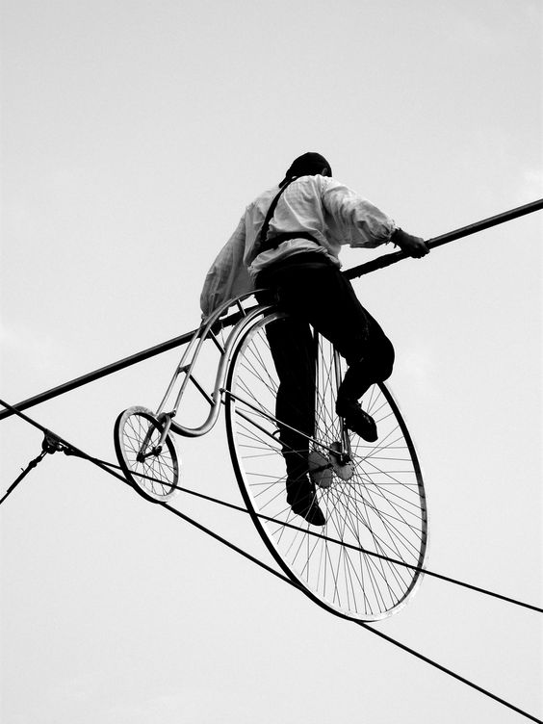
And balance.
The Goldilocks principle.
Not too much and not too little.
Just right.
Notes:
Between stories and analysis.
Reason and emotion.
Abstraction and examples.

Slide 19
The last word.
Presentations rise or fall on the quality of the idea,
the narrative, and the passion of the speaker.
Chris Anderson

Slide 20
References
Ken Robinson: https://www.npr.org/2014/10/04/353679082/dancer-needed-to-move-to-think
Image of Dame Gillian Lynn: Baron/Getty Images
Robert McKee: https://hbr.org/product/storytelling-that-moves-people/R0306B-PDF-ENG
Chris Anderson: How to give a killer presentation. HBR June 2013
On academic writing as storytelling. For example:
https://www.annaclemens.com/blog/story-structure-scientific-paper

